Slide 1

Master’s Thesis “Quantum Computing Algorithms with Feasible Photonic Implementation” "خوارزميات الحوسبة الكمية وإمكانية تنفيذها بنظم ضوئية"
by Ahmed Saad El Fiky
MSc (Physics) student

Slide 2
Supervised by:
Assoc. Prof. Abdulghany Reda Abdulghany
Faculty of Science, Cairo University
Assoc. Prof. Salem Farag Hegazy
National Institute of Laser Enhanced Sciences, Cairo University
Prof. Ahmed Younes Mohamed
Faculty of Science, Alex. University

Slide 3
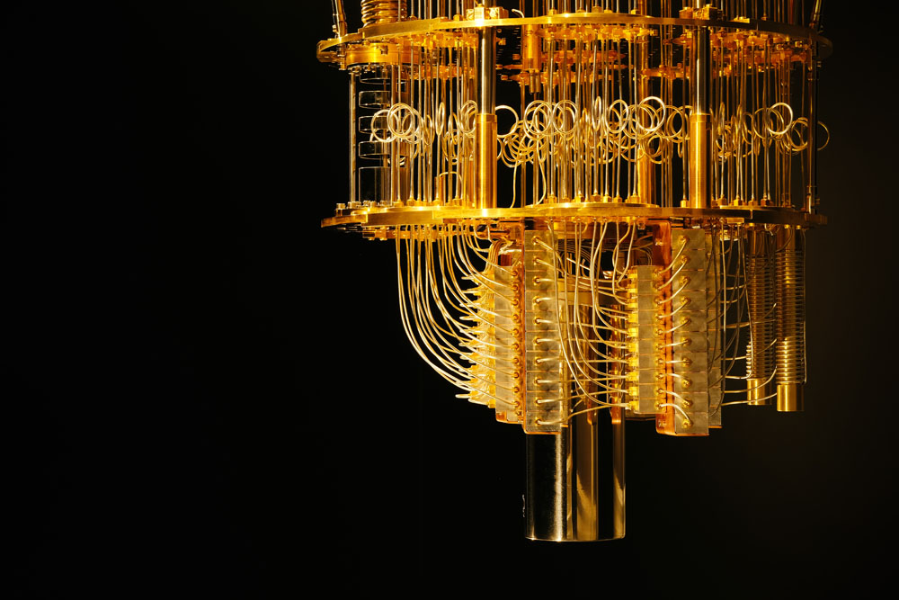
Quantum computing is the future of computing.
It has the potential to revolutionize industries such as finance, healthcare, and energy.

Slide 4
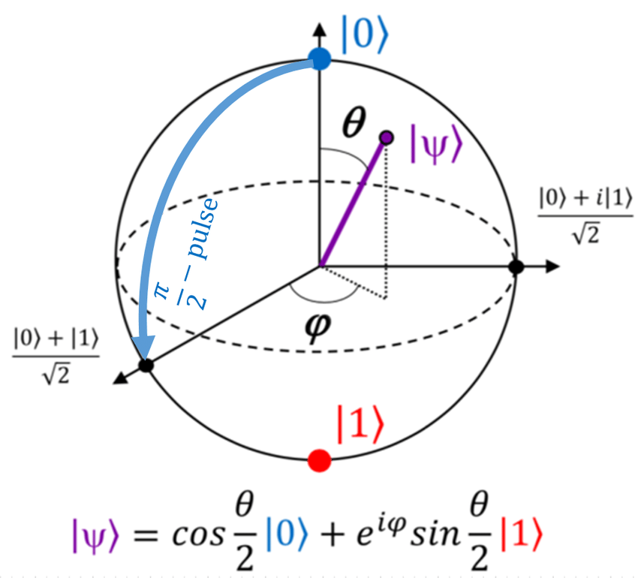
What is Quantum Computing?
Quantum computing is a type of computing that uses qubits instead of classical bits.
Qubits can exist in multiple states at once (superposition), allowing for faster computing. Quantum computing has the potential to solve problems that are impossible for classical computers to solve.

Slide 5
What is Quantum Computing?
Quantum computing leverages the advantage of quantum parallelism and interference to make computations.
Unlike classical computing algorithms, quantum algorithms provide reliable and speed solutions to wide range of nowadays important problems. Quantum computing could enable tremendous improvements over traditional computing methods for certain types of problems, such as factoring large numbers into primes, and efficiently searching a database.

Slide 6
Research lines:
Analysis of some well-known quantum computing algorithms (e.g., Grover’s, Enhanced Quantum Search Algorithm, …).
Design of a circuit gate model for some of the selected algorithms.
Optimizing the circuit to its basic gates using simulation and optimization tools.
Study of photonic implementations for some 1-qubit gates and 2-qubit gates.
Design of optical setups that implement selected algorithm(s).

Slide 7
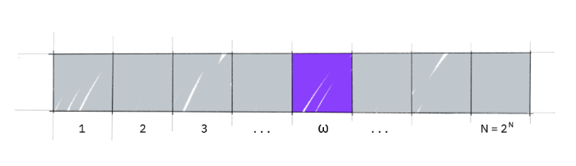
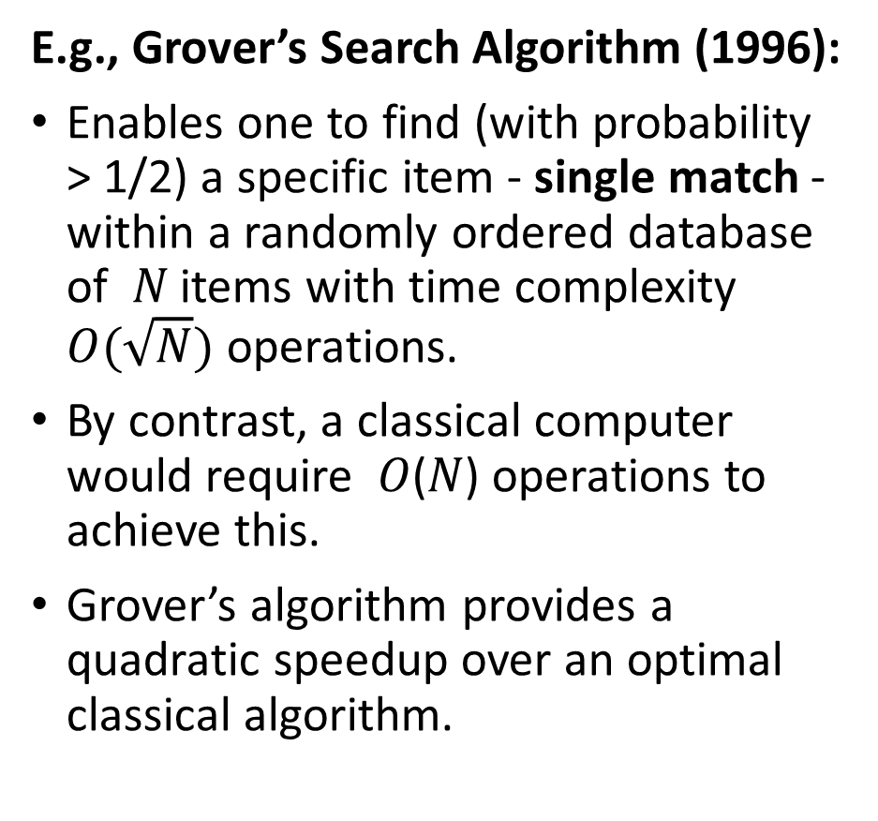
Analysis of some well-known quantum computing algorithms
E.g., Grover’s Search Algorithm (1996):
Enables one to find (with probability > 1/2) a specific item - single match - within a randomly ordered database of 𝑁 items with time complexity $O(\sqrt{N})$ operations.
By contrast, a classical computer would require 𝑂(𝑁) operations to achieve this.
Grover’s algorithm provides a quadratic speedup over an optimal classical algorithm.

Slide 8
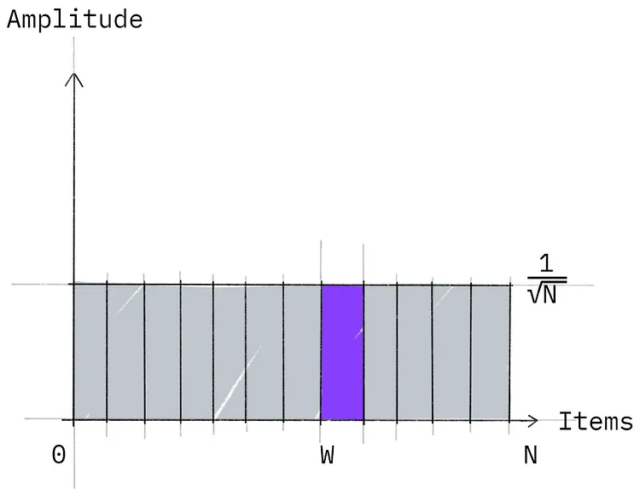
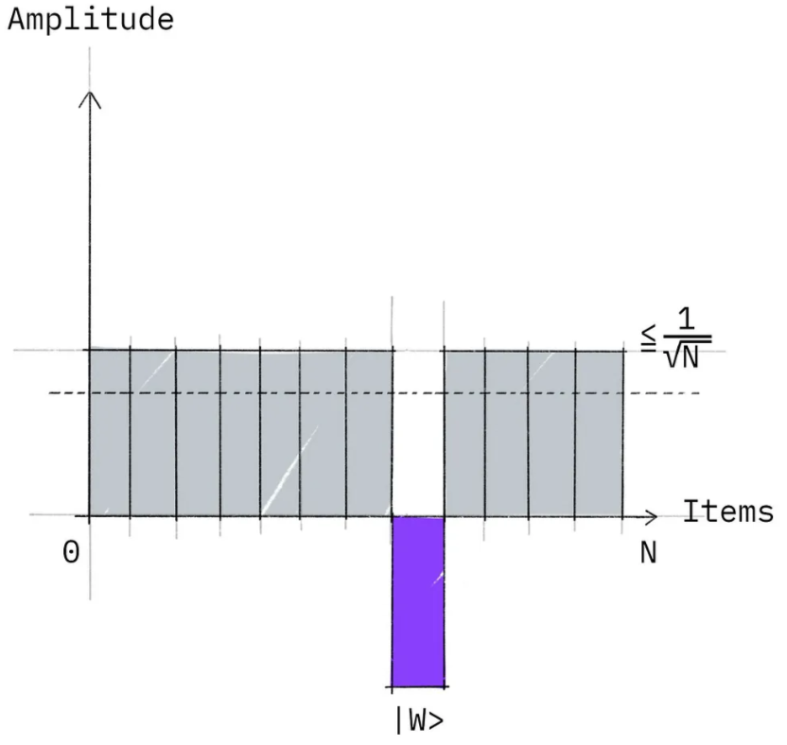
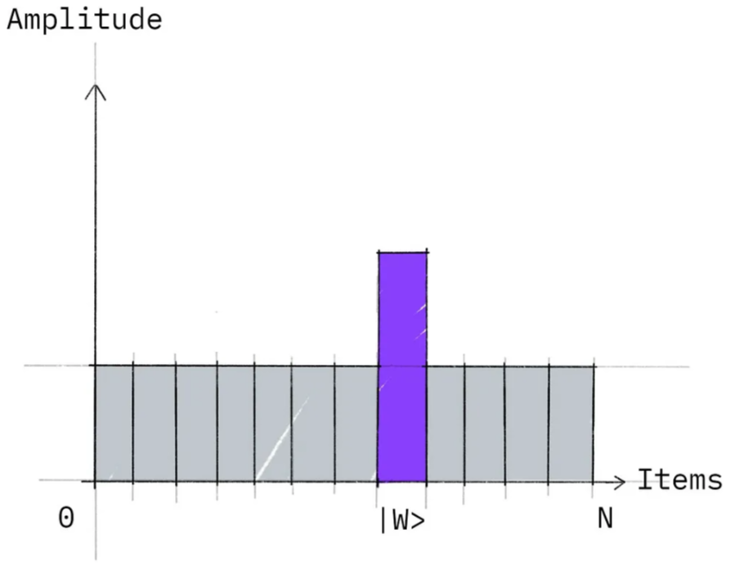
Grover's Search Algorithm
Step 2: Marking the winner state: Implement an Oracle that will mark the state you wish to find by phase flip – Phase kickback.
Step 3: Amplitude amplification: Implement the Diffusion Operator that further increases the marked states amplitude, while decreasing the amplitude of all other states.
Step 1: State initialization: equally-weighted superposition for all states, including the winner state.

Slide 9
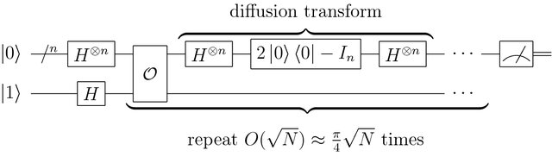
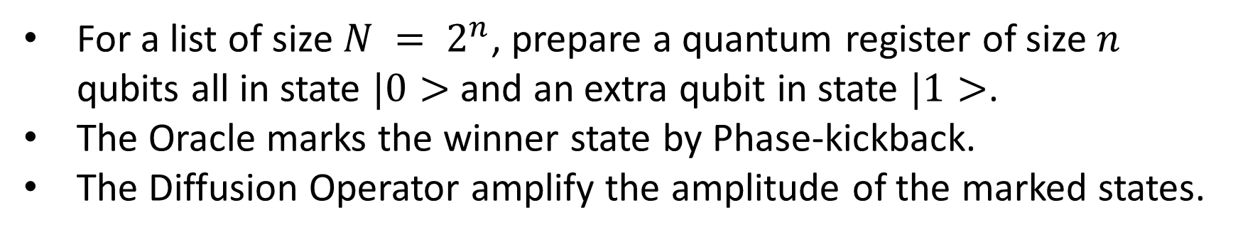
Grover's Search Algorithm
For a list of size $N = 2^{n}$, prepare a quantum register of size $n$ qubits all in state $|0>$ and an extra qubit in state $|1>$.
The Oracle marks the winner state by Phase-kickback.
The Diffusion Operator amplify the amplitude of the marked states.

Slide 10
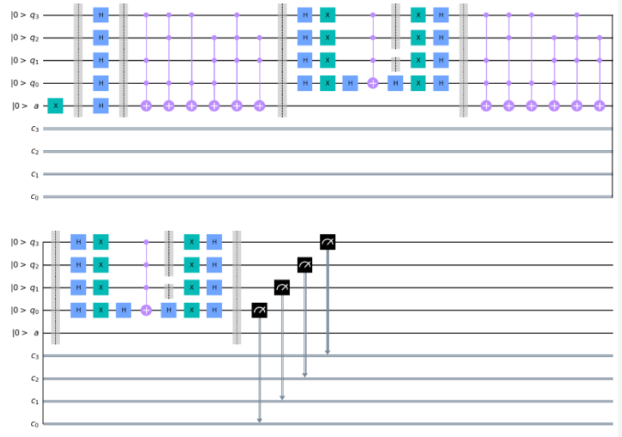
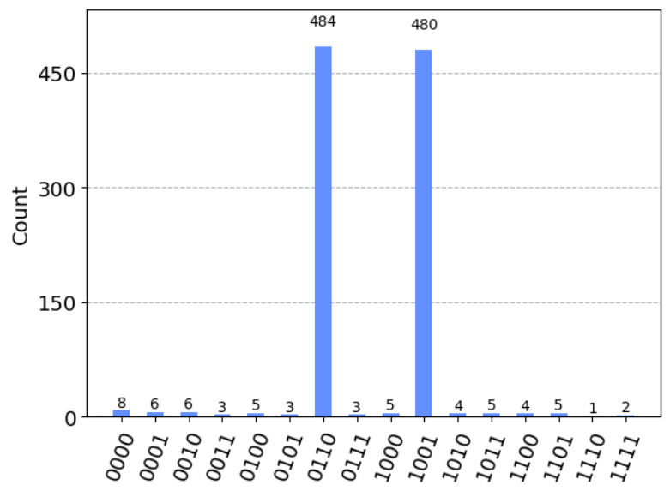
Qiskit Circuit for a problem solved using Grover's Search Algorithm
Circuit Gate model using Quantum Information Software Kit Qiskit by IBM.
Results: Probabilities of getting the winner states using quantum simulator.

Slide 11
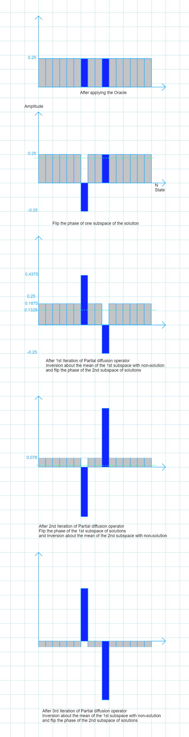
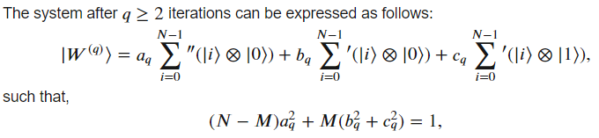
Younes et. al. Enhanced Quantum Search Algorithm via entanglement and partial diffusion:
The main idea of using the partial diffusion is to split the subspace of the solutions into two smaller subspaces.
In each iteration, one of the solution subspaces will be inverted about the mean (together with the non-solution subspace) while the other half will have the sign of their amplitudes changed to the negative sign, preparing it to be inverted about the mean (together again with the non-solution subspace) in the next iteration.
The benefit of this alternating inversion is to preserve half the number of the solution states at each iteration so as to resist the de-amplification behavior of the standard diffusion operator when reaching the so-called turning points.

Slide 12
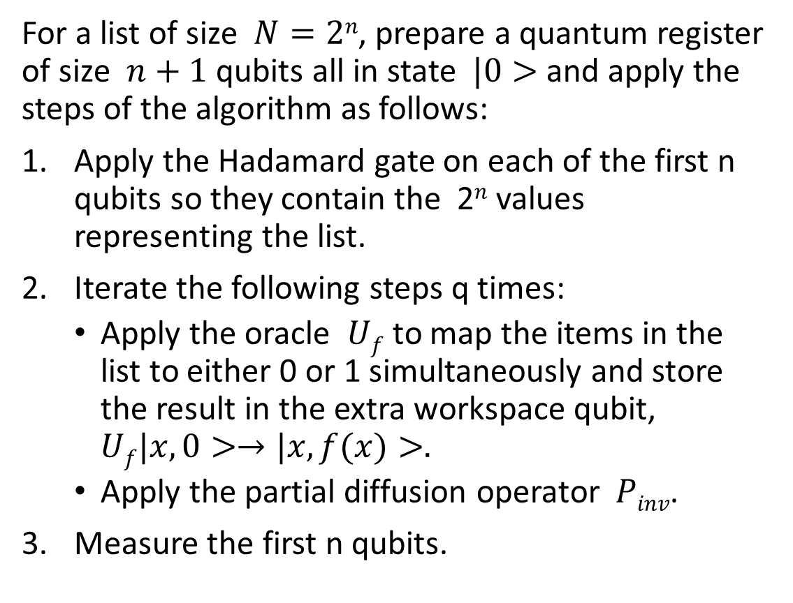
Younes et. al. Enhanced (Partial Diffusion) Search Algorithm:
For a list of size $N=2n$, prepare a quantum register of size $n+1$ qubits all in state $|0>$ and apply the steps of the algorithm as follows:
Apply the Hadamard gate on each of the first n qubits so they contain the 2^{𝑛} values representing the list.
Iterate the following steps q times:
Apply the oracle $Uf$ to map the items in the list to either 0 or 1 simultaneously and store the result in the extra workspace qubit, $Uf|x,0>→|x,f(x)>.$
Apply the partial diffusion operator 𝑃_{𝑖𝑛𝑣}.
Measure the first n qubits.

Slide 13
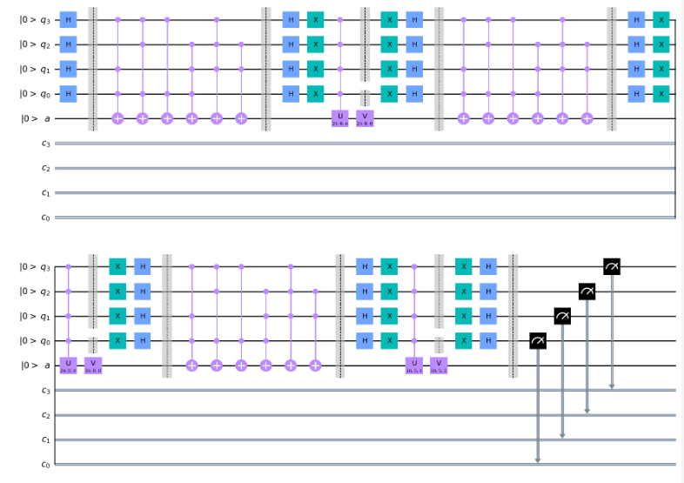
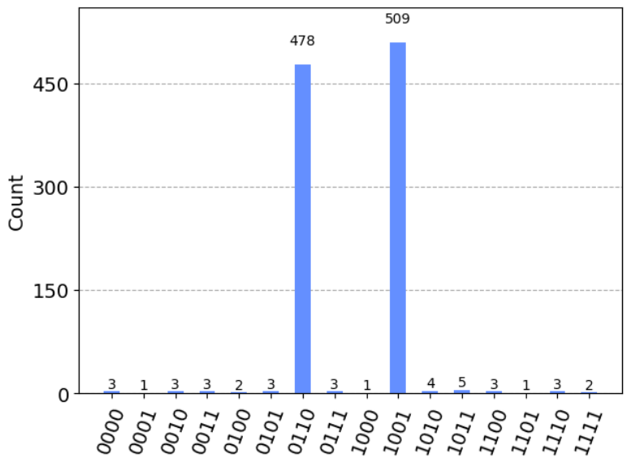
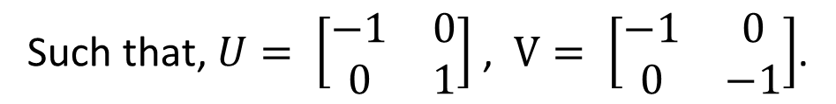
Qiskit Circuit for a problem solved using Partial Diffusion Operator Search Algorithm:
Such that, $U= \left[\begin{matrix}−1 & 0 \\ 0 & 1\end{matrix}\right]$ , $V= \left[\begin{matrix}−1 & 0 \\ 0 & −1\end{matrix}\right]$.
Results: Probabilities of getting the winner states using quantum simulator.

Slide 14
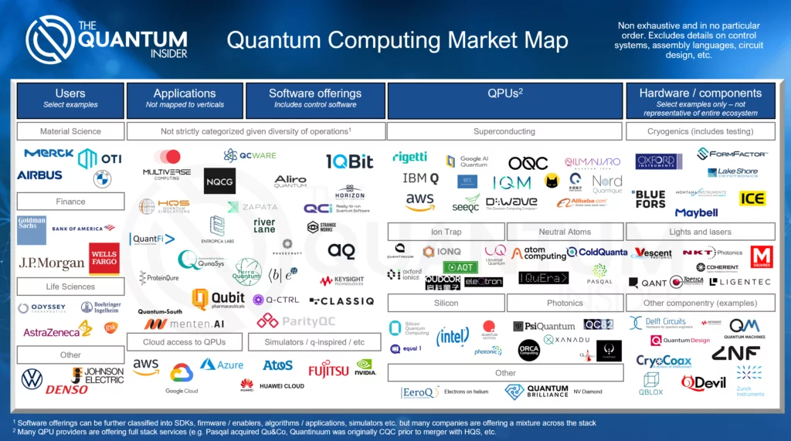
Platforms studied for providing reliable hardware quantum computer
Electrons:
Silicone-based circuits.
Quantum electronic cavity (QED),
Superconducting integrated circuits
Super-cold electrons.
Atoms:
Trapped ions,
Neutral Atoms.
Quantum dots,
Nuclear magnetic resonance (NMR)
Photons:
Two-level encoding (Dual-rail) based on circuit gate model.
Multi-level encoding (GKP state) based on One-way Cluster model.

Slide 15
Using photons as a quantum computing platform “ Photonic-based Quantum Computing “
Advantages:
Room temperature processing and do not need complex infrastructure.
Mostly based on existing optical components which also enables integration into the classical computing infrastructure.
All-Gaussian linear optics processing using Beam splitters and homodyne detectors.
Modularity, Correctability, Scalability and networkability.
Low overheads for fault-tolerance.
Disadvantages:
Photons weakly interact with each other.
Challenges:
Probabilistic character of the photons and the so far limited quality of the single photon sources.
Photons cannot be ‘stopped’ or stored for a long term, limits the number of operation and coherence time.

Slide 16
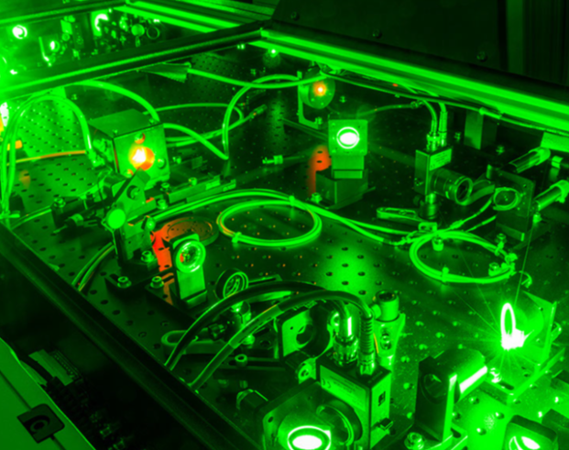
Linear optics is sufficient for efficient QIP with photons with polynomial resources
Requirements:
Single-photon sources,
Beam splitters,
Phase shifters = wave plates = retarders,
Photo-detectors,
and feedback from photo-detector outputs.

Slide 17
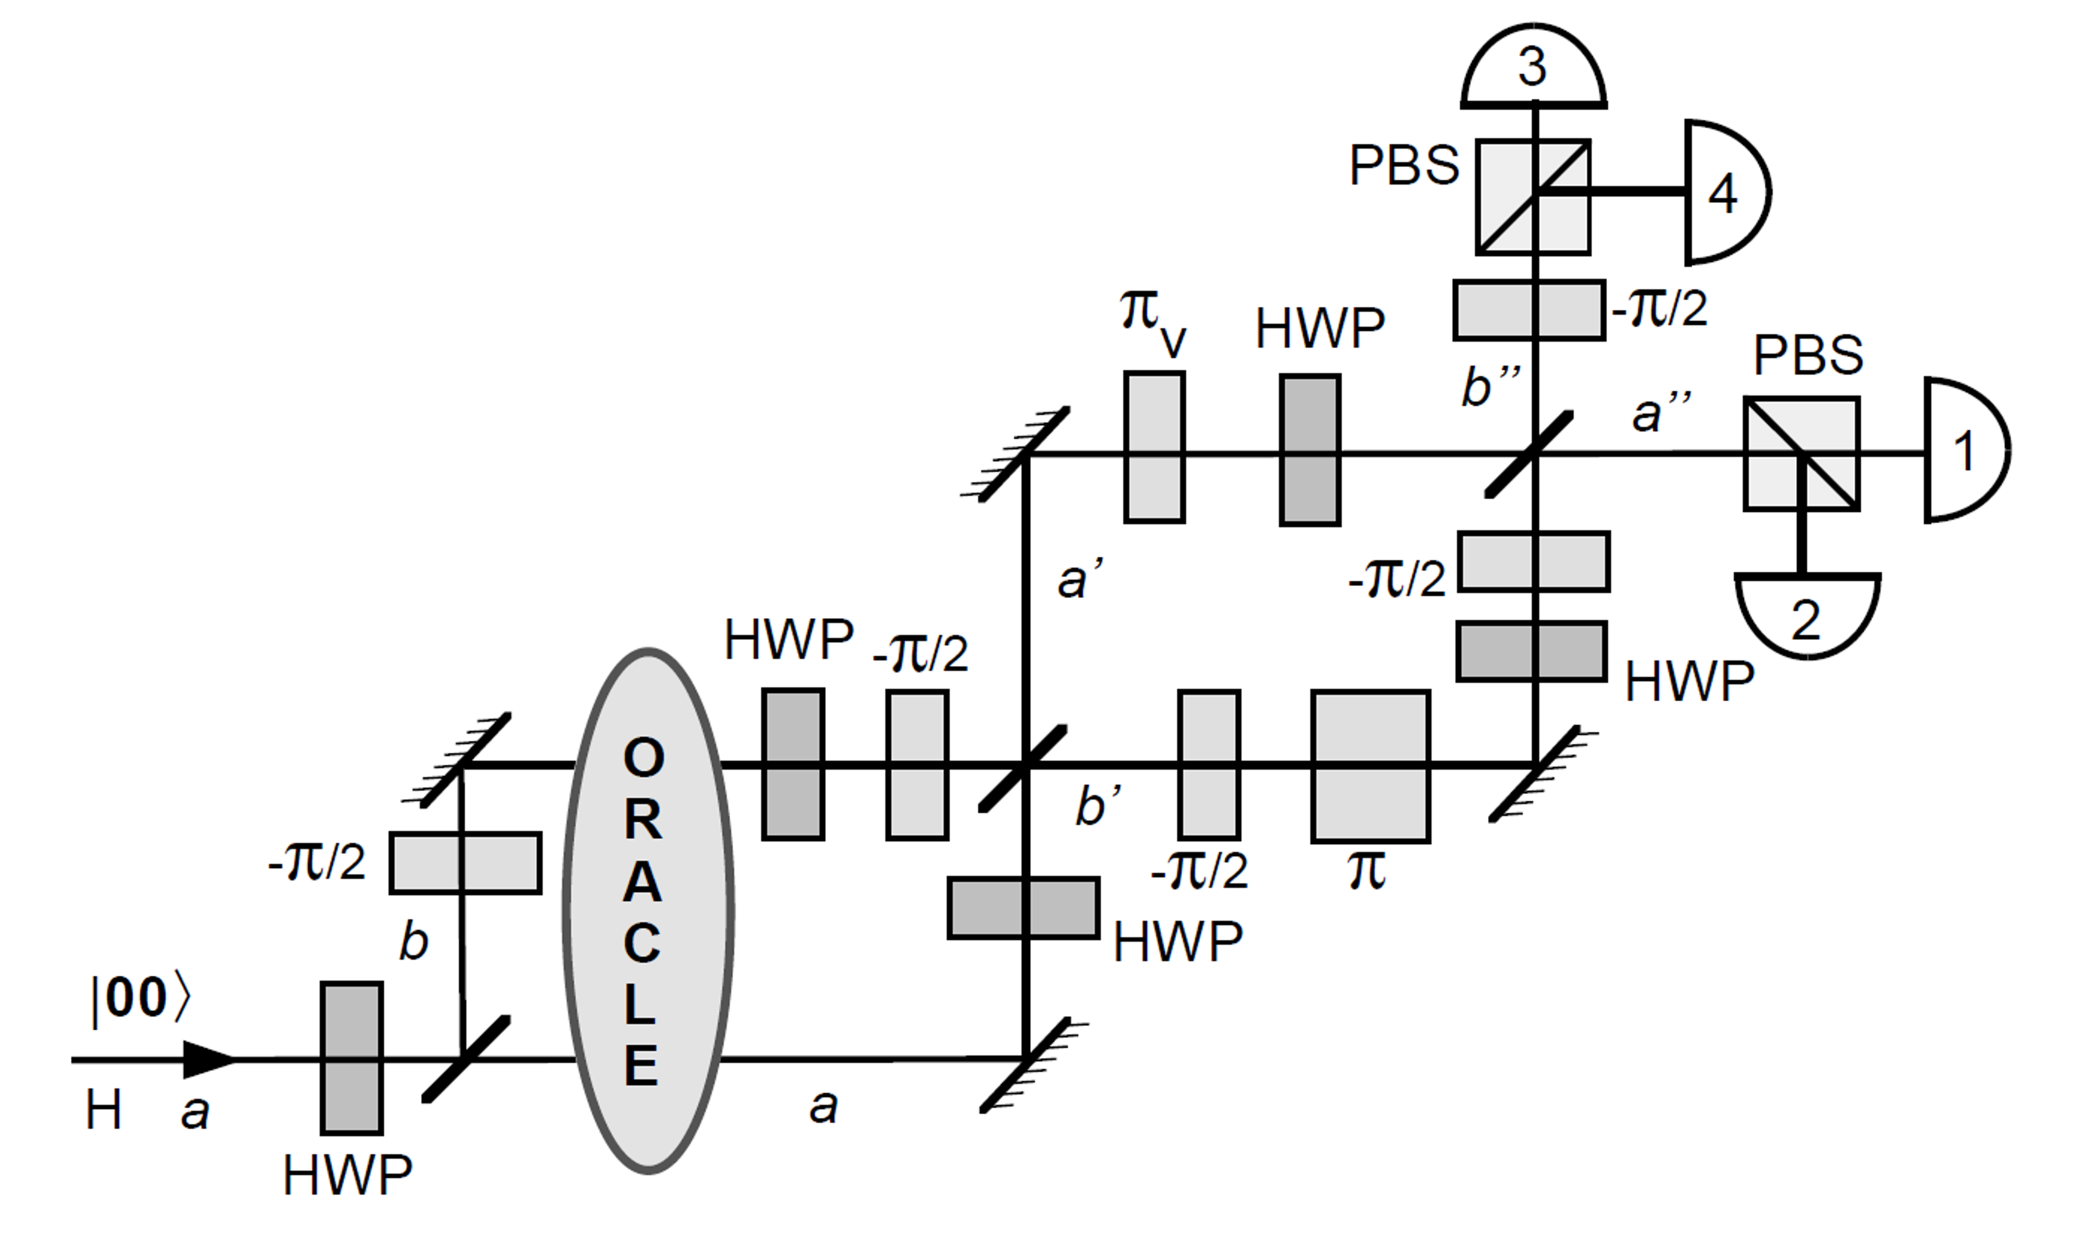
Proposed Optical setup for Grover’s Algorithm:
All the basic circuit elements of quantum computation can be accomplished using only linear passive optical elements with single-photon.
A half wave-plate (HWP) oriented at 22.5◦ can perform Hadamard transformation on the polarization degree-of-freedom, H & V.
A simple 50-50 beam-splitter (BS) performs the H-transform on spatial modes – right & upward propagation.
Mirrors and Phase shifters are used for Phase compensation.
A polarizing beam-splitter (PBS) in the H-V basis used to examine each of the outputs.
Then state are detected by photo-detectors.
A one-to-one optical implementation of the circuit, Proposed by P. G. Kwiat et. al., for the case of n=2 bits (one represented by polarization and the other by spatial mode.) All half waveplates (HWP) are oriented at 22.5◦.

Slide 18
Summary
Analysis of some well-known quantum computing algorithms (e.g., Grover’s, Enhanced Quantum Search Algorithm, …).
Design of a circuit gate model for some of the selected algorithms.
Optimizing the circuit to its basic gates using simulation and optimization tools.
Study of photonic implementations for some 1-qubit gates and 2-qubit gates.
Design of optical setups that implement selected algorithm(s).

Slide 19
RESOURCES
PAPERS:
L. Grover, A fast quantum mechanical algorithm for database search, in: Proc. of the 28th Ann. ACM Symp. on the Theory of Computing, 1996, pp. 212–219.
A. Younes, J. Roweb, J. Millerc, Enhanced quantum searching via entanglement and partial diffusion, Physica D 237 (2008) 1074–1078.
P. G. Kwiat, J. R. Mitchell, P. D. D. Schwindt & A. G. White, Grover's search algorithm: An optical approach, Journal of Modern Optics, 1999, Volume 47.
M. Nielsen, I. Chuang, Quantum Computation and Quantum Information, Cambridge University Press, Cambridge, United Kingdom, 2000.
WEBSITES:
https://learn.qiskit.org/course/ch-algorithms/grovers-algorithm

Slide 20
Thanks! Time for questions!

